Slide 1
APEC 2016 Ease of Doing Business Workshop：
One-Stop Shops Improve
the Business Environment
Chinese Taipei
National Development Council
26-27 February, 2016

Slide 2
Outline
■ Overview
Chinese Taipei One-Stop Shops
Starting a business reform’s benefits
2

Slide 3
Overview
Introduce
7 Years EoDB reform
Indicators ranking change
3

Slide 4
Introduce
In October 2008, Chinese Taipei launched business environment reforms based on the criteria of the World Bank’s Doing Business report, and has advanced them for seven consecutive years as of May 2015.
Chinese Taipei’s Ease of Doing Business ranking rose from 61th in 2008 to 11th in 2015, in seven years Chinese Taipei moved up 50 places in the rankings. Its highest ever ranking.
In April 2010, the Executive Yuan promulgated the Procedural Directions on the Conduct an Assessment of Business Environment Reform by Agencies of the Executive Yuan, under which the Deputy Premier of the Executive Yuan acts as the top level of oversight.
Cabinet agencies form an interagency task force, and the National Development Council puts forward reform proposals each year, and coordinates between agencies and evaluates their progress in implementing reforms.
4

Slide 5
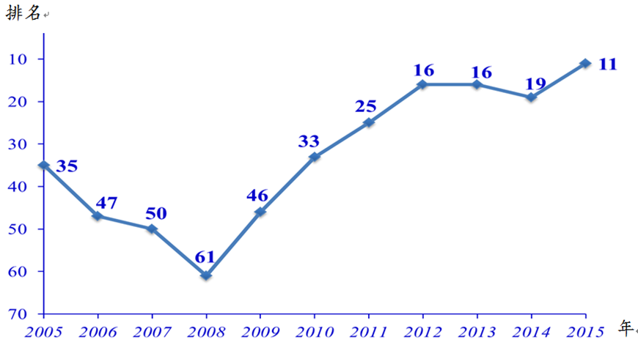
7 Years EoDB reform
- 2015 Chinese Taipei ranked 11th
rank
year
5

Slide 6
Indicators ranking change
- 5 indictors highest ever ranking
Launched Year |  | 2015 | 2014 | 2013 | 2012 | 2011 | 2010 | 2009 | 2008 | 7-years ranking change
Chinese Taipei EoDB rank |  | 11 | 19 | 16 | 16 | 25 | 33 | 46 | 61 | ＋ 50
1 | Starting a Business | 22 | 15 | 17 | 16 | 16 | 24 | 29 | 119 | ＋ 97
2 | Dealing with Construction Permits | 6 | 11 | 7 | 9 | 87 | 95 | 97 | 127 | ＋ 121
3 | Getting Electricity | 2 | 2 | 7 | 6 | 3 | - | - | - | ＋ 1
4 | Registering Property | 18 | 40 | 31 | 32 | 33 | 32 | 30 | 26 | ＋ 8
5 | Getting Credit | 59 | 52 | 73 | 70 | 67 | 72 | 71 | 68 | ＋ 10
6 | Protecting Minority Investors | 25 | 30 | 34 | 32 | 79 | 74 | 73 | 70 | ＋ 45
7 | Paying Taxes | 39 | 37 | 58 | 54 | 71 | 87 | 92 | 100 | ＋ 61
8 | Trading Across Borders | 65 | 32 | 18 | 23 | 23 | 17 | 33 | 30 | ＋ 35
9 | Enforcing Contracts | 16 | 93 | 84 | 90 | 88 | 90 | 90 | 88 | ＋ 72
10 | Resolving insolvency | 21 | 18 | 16 | 15 | 14 | 10 | 11 | 11 | － 10
6

Slide 7
Chinese Taipei One-Stop Shops
In three priority areas
Chinese Taipei’s starting a business
Reform starting a business strategy
One-stop shops flow chart
7

Slide 8
In three priority areas
- Chinese Taipei one-stop shops
Starting a Business ( https://onestop.nat.gov.tw/oss/identity/Identity/init.do)
● Cross Trading Border
(https://portal.sw.nat.gov.tw/PPL/;PPLJSESSIONID=yPZWWKjbRkRzl28lwR6nkGlN6ML411TQvvnlgpJcKWjpnTrJ0lCP!1710121630)
Dealing with Construction Permits
(http://english.dba.gov.taipei/)
8

Slide 9
Chinese Taipei’s starting a business
- WB survey
No. | DB 2016 | No. | DB 2009
1 | Use the online application to search the name, apply for incorporation and tax registration, apply for Labor Insurance, National Health Insurance and register for work rules with the Council of Labor Affairs (https://onestop.nat.gov.tw/oss/web/Show/engWorkFlow.do) | 1 | Search the uniqueness of company; reserve company name and apply for MOEA approval
 |  | 2 | Make a company seal
 |  | 3 | Deposit capital in a bank
 |  | 4 | Have a certified accountant verify and sign the paid-in capital
 |  | 5 | Apply for incorporation at the Ministry of Economic Affairs(MOEA)for large companies with paid-in capital of more than or equal to TWD 500 million, or Taipei city office of commerce for companies with paid-in capital under TWD 500 million
2 | Make a company seal
 |  | 6 | Apply for business license and taxpayer identification number from Municipal Government(for tax purpose)
3 | Submit a CPA audit report showing that the amount of capital invested is sufficient to cover company establishment cost
 |  | 7 | Apply for labor Insurance, National health Insurance and Pension Plan with Bureau of Labor Insurance
 |  | 8 | Register with Labor Standard Legislation(LSL) scheme for retirement and works rule
9

Slide 10
Reform starting a business strategy
Step1：Regulatory Reform (April,2009)
Simplified labor and health insurance enrollment
Abolishing the minimum capital requirement for starting a business
Terminated the uniform certification system for profit-seeking enterprises
Amended the Directions for Reviewing of Work Rules to stipulate the timeframe for review and approval
Step2：Building One-Stop Shop (March,2011)
Completed the establishment of the Company and Business One-Stop Service Request website
10

Slide 11
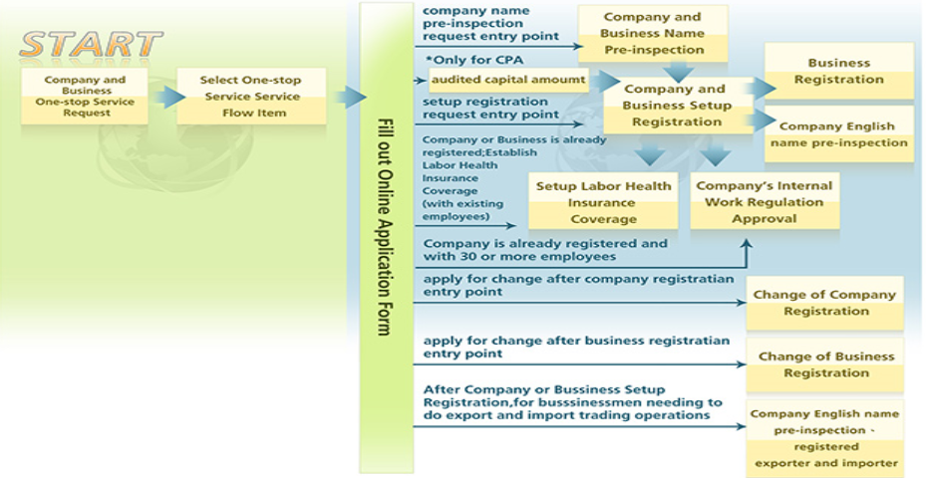
One-stop shop flow chart
- Starting a business
11

Slide 12
Starting a business reform’s benefits
Company numbers & Unemployment change
Business numbers & Unemployment change
12

Slide 13
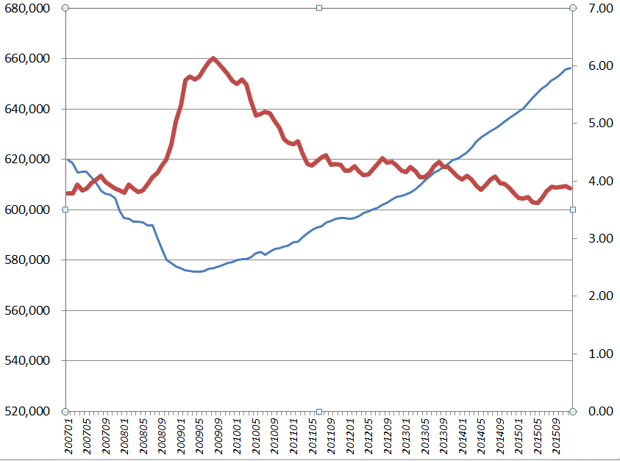
Company numbers & Unemployment change
April,2009
Company numbers：575,300
Unemployment：5.78%
●
December,2015
Company numbers：656,333
Unemployment：3.87%
●
13

Slide 14
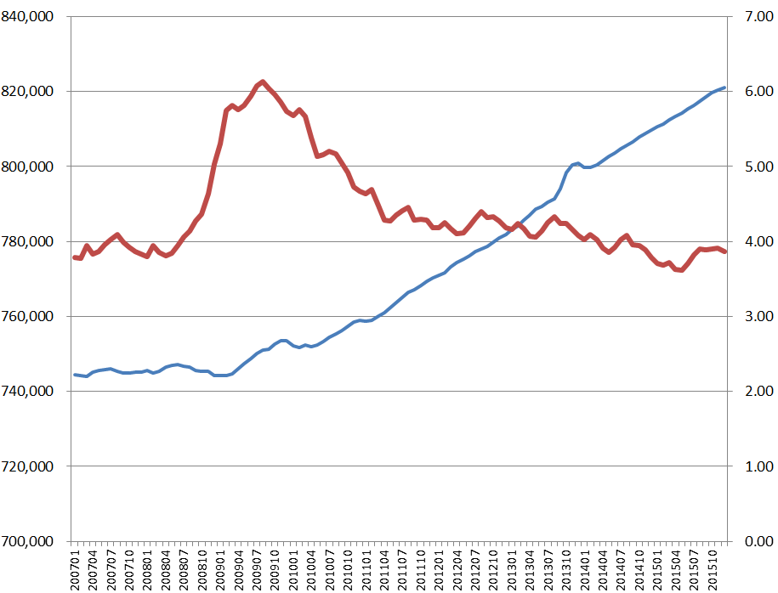
Business numbers & Unemployment change
April,2009
Business numbers：746,036
Unemployment：5.78%
●
December,2015
Business numbers：821,407
Unemployment：3.87%
●
14

