Slide 1
The First Choice for a Winning
Position in the Asia-Pacific Region
－FEPZs

Slide 2
Outline
Taiwan: the Best Choice for Investment
New Highlight for Investing in Taiwan: Free Economic Pilot Zones (FEPZs)
Exclusive Privileges for FEPZs Businesses
Priorities for FEPZs Development
Introduction to the 8 Newly-Established FEPZs
FEPZs Contact Information

Slide 3
Taiwan: The Best Choice for Investment

Slide 4
Taiwan: The Best Choice For Investment
10 Good Reasons to Invest in Taiwan
A dynamic and open economy
Strategic location in the Asia-Pacific region
World-leading manufacturing and hi-tech industries
Comprehensive supply chains and industrial clusters
Complete infrastructure and abundant capital
Proximity to and linguistic/cultural affinity with Mainland China
Close economic and trade relations with neighboring countries
Low taxes (an average tariff rate of just 4.23% on industrial products and a business income tax rate of only 17%.)
It signed the Economic Cooperation Framework Agreement (ECFA) with Mainland China in 2010.
A democratic, diverse, open, and friendly civil society

Slide 5
New Highlight for Investing in Taiwan: Free Economic Pilot Zones

Slide 6
Core Ideas of FEPZs
FEPZs are an important milestone in Taiwan’s launching of a new wave of economic liberalization. The core ideas are:
Liberalization, internationalization
Loosening restrictions on the free movement of personnel, goods, capital, and information.
Market opening: Treatment granted to foreign capital enterprises in FEPZs will move from WTO treatment to WTO+, while to Mainland Chinese-invested enterprises from ECFA to WTO
Forward-looking
The activities selected for development in the zones will be those that have strong growth potential, are innovative, and can play a demonstrative role, and can create greater economic benefits as well.

Slide 7
Schedule of the Two-Phase Liberalization
Phase 1
FEPZs Phase 1 Promotion Plan launched in August, 2013.
Draft of the Special Act for Free Economic Pilot Zones passed by the Executive Yuan in December 2013 and sent to the Legislative Yuan for review.
Phase 2
To be activated after the special law being enacted by the Legislative Yuan.
During Phase 2 of the promotion plan, new FEPZs could be created either through central government’s planning or via the applications issued by local governments.

Slide 8
Exclusive Privileges for FEPZs Businesses

Slide 9
Exclusive Privileges for FEPZs Businesses
Promotion of free movement of personnel, goods, and capital
Opening up the market to be in line with international norms
Breaking through the legal restrictions
Innovative management mechanism
Provision of tax incentives
Promotion of cross-border industrial cooperation
Fast and convenient land acquisition
Building a superior operating environment
Dual-track pilot mechanism

Slide 10
Promotion of Free Movement of Personnel, Goods, and Capital
Liberalization of entry and exit of personnel
Loosening restrictions on foreign professionals coming to Taiwan to work.
Expanding scope of short term visa exemption or landing visas for international business people coming to Taiwan.
Loosening restrictions on Mainland Chinese people coming to Taiwan for business or residence .
Liberalization of goods flow
Free import in principle of agricultural and industrial raw materials and goods.
Tax incentives for import of industrial raw materials and goods.
Reform of inspection and examination system (for example, pre-market entry examination exemption if an SDoC is provided by the product maker).
Liberalization of capital flow
Free movement of zone businesses’ capital.
Provision of services by OBU for non-NT$ capital requirements of international personnel in FEPZs.

Slide 11
Opening Up Market to be in Line with International Norms
Treatment of FEPZs foreign capital enterprises will move from WTO to WTO+
Loosening restrictions on investment in professional services, such as lawyers, accountants, and architects.
Treatment of Mainland Chinese invested enterprises in FEPZs to move from ECFA to WTO
Mainland Chinese manufacturing industries investing in FEPZs to be treated like foreign investments; while treatment of Mainland Chinese services industries investing in FEPZs to take WTO commitments into consideration, being supported by an review mechanism.
Simplifying the foreign investment process by changing to post-facto reporting for investment cases below a certain amount

Slide 12
Provision of Tax Incentives
For international goods owners (including Mainland China, Hong Kong, and Macau) engaging in goods storage or simple processing in FEPZs, 100% of the export and 10% of the domestic sale will enjoy business income tax exemption.
To encourage foreign (/mainland Chinese) professionals to come to work in Taiwan, they are exempt from reporting foreign source income under the lowest tax burden system and for the first 3 years only half of the salary would be taxed.
To encourage Taiwanese businesses to invest more in Taiwan, overseas dividends and earnings repatriated by Taiwanese companies for substantive investment in FEPZs are exempt from income tax.

Slide 13
Promoting Cross-Border Industrial Cooperation
FEPZs have a good environment and all industries are encouraged to engage in cross-border cooperation.
Enterprises are encouraged to import key technology, intellectual property or capital so as to promote cross-border cooperation.
Utilize Taiwan’s position in the international industrial value chains to promote cross-border industrial cooperation so as to jointly open up new emerging markets.
Use the FEPZs to promote industrial cooperation with other countries and strengthen zone-to-zone cooperation.

Slide 14
Fast and Convenient Land Acquisition
To strengthen land acquisition: public land will be acquired through allocation or sale, private land through contract price-purchase, renting, granting right of superficies, or joint development.
To expedite the review process of land use zoning change: In FEPZs developed by the central government, land use change will adopt the “one grade, one review” approach. For FEPZs being transformed from existing industrial parks or zones, a future reference approach could be adopted for non-urban land.
Flexible control of land use: The zone competent authorities can independently formulate land use plans, which could be implemented after receiving approval.

Slide 15
Building a Superior Operating Environment
Provision of high-efficiency one-stop service window
One-stop service window overseen by a program manager, for providing such services as business registration, land management, building management, environmental protection permit review, labor affairs, taxes, etc.
Provision of public infrastructure required for industrial development
Provision of complete ICT infrastructure

Slide 16
Dual-Track Pilot Mechanism
Industries with clear physical location will be piloted within physical zone areas and linked with companies outside the zones via a “shop onsite, factory offsite” operation model.
Industries not suitable for being confined to physical zone areas will be conducted at designated trial-points, with loosened pilot operation scope and separate-grade management.
Pilot models to be defined by competent authorities
Industries not feasible for implementation in physical zone areas
Approved FEPZ businesses
Stratified management
Geographically defined location
Approved FEPZ businesses
Physical
Zone areas
(shop onsite)
Designated trial-points
Any location outside the zone
Outsourced processing
(factory offsite)

Slide 17
Priorities for FEPZs Development

Slide 18
Priorities for FEPZs Development
Smart logistics
High-value-added service industries
Manufacturing industries that can promote services industries
International
health care
Value-added agriculture
Financial services
Education innovation

Slide 19
Smart Logistics
To use e-ledgers, innovative customs mechanisms, and cloud computing platforms, and other ICT infrastructure to facilitate goods movement and to employ the “shop onsite, factory offsite” operation model to expand the scope and depth of processing.
Innovative customs mechanisms
Non-FEPZ
OEM processing
Industrial parks
Export processing zones
Science parks
Agricultural parks
Other parks
Manufacturing industries
Shop onsite, Factory offsite
FEPZs
Manufacturing & processing
Foreign goods owner or suppliers
Air and sea ports
Logistics and Distribution Center
Manufacturing industries
Best logistics practice

Slide 20
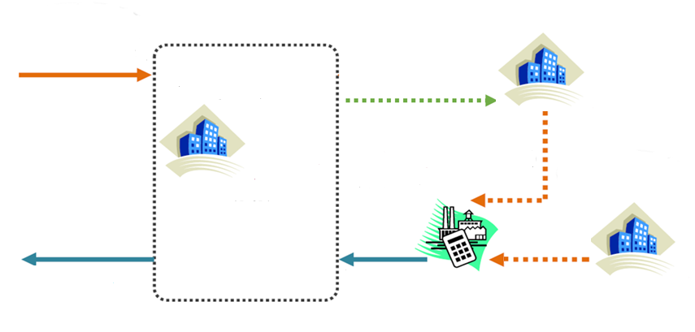
Smart Logistics：“Shop Onsite, Factory Offsite” Case Study
30%
components
Duty area
Import components from overseas
21 collaborating suppliers North of Hsinchu City: Assembling of semi-finished car chassis, car body plating etc.
Taipei Free Trade Port
OEM processing
Kuozui Motors, Zhongli City branch (entrusted supplier) : Car assembling
Tonglit Logistics Co., Ltd (entrusting company)
70%
components
Ship the semi-products to the entrusted supplier
Warehouse, Logistics and distribution, processing
Export overseas
Export whole car
Domestic product: Tainan car Lights, Kaohsiung Glass, Hsinchu car interior etc.
Data Source: Taiwan International Ports Corporation Ltd.

Slide 21
Smart Logistics
Taiwan’s advantages
Superior geographical location.
High-quality sea and air transport facilities.
High level of computerization of the industrial supply chain and excellent ICT capabilities.
Business opportunities for enterprises
Since 2013, the air- and seaport goods volume grew by 30% for three consecutive years and will reach 22 million tons in 2015 according to prediction.
The value of trade will double and break the NTD $1 trillion mark in 2015.

Slide 22
International Health Care
The establishment of International Healthcare Industry Parks will be promoted, with dedicated international healthcare and biotechnology R&D institutes created to develop medical treatment (including serious illnesses), biotechnology, pharmaceutical, rehabilitation, health-preservation, and other health-related industries.
Internationally famous biotechnology, medical treatment and instrument operators
Import specialized technology and capital
International Healthcare Industry Park
Referrals to domestic hospitals for follow-up treatment based on the medical condition
Foreigners
Medical treatment
Biotech
Pharmaceutical
Rehabilitation
Health-preservation
Scenic spots, Malls
Auxiliary value-added services
Domestic and International tourism, insurance, and legal service providers

Slide 23
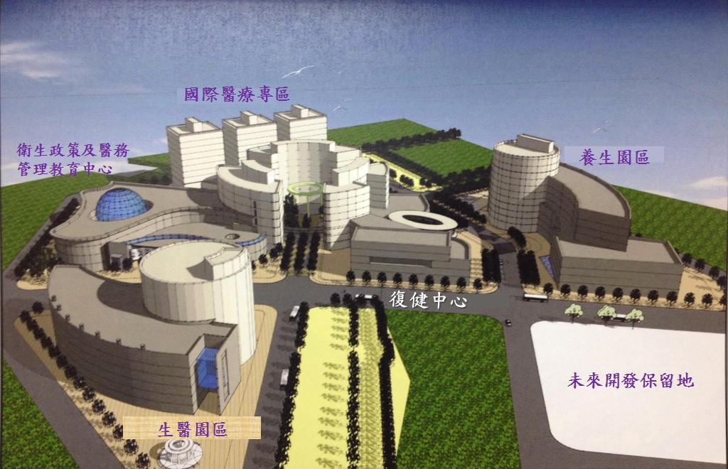
Diagram of a Healthcare Industry Park
International Medical Care Special Zone
Health Policy and Medical Affairs Management Education Center
Health-Preservation Park
Rehabilitation Center
Land Reserved for Future Development
Biotech Park

Slide 24
International Health Care
Taiwan’s advantages
Medical technology reaches international level.
Medical treatment price is attractive.
The number of visitors to Taiwan has increased sharply and the number of medical care tourists has increased in recent years.
Use Taiwan’s high level medical technology in conjunction with the joint development of bio-tech, drug, health preservation and other health industries to create an industrial cluster effect, which will make Taiwan an attractive place for people overseas to visit for medical services.
Taiwan’s international health related output value will reach NT$38.7 billion in 2016 and will drive the development of the domestic medical tourism.
Business opportunities for enterprises

Slide 25
Value-Added Agriculture
Expanding Taiwan’s quality “agricultural products” into a high-value “value chain” and using Taiwan’s high-quality agricultural technology to promote innovative and value-added products and market them internationally under the MIT brand.
Plans will be made to develop key agricultural industries such as tea production, aquarium fish (and shrimp), and animal vaccines.
Marketing Worldwide
FEPZ - Value-added agriculture
Agricultural Technology commercialization
Value-added agriculture
Domestic agriculture, fishery and animal husbandry products
Imported raw materials
(All value-added products have to be exported if they are import-controlled products)
or
contracted farms or satellite farms

Slide 26
Value-Added Agriculture
Taiwan’s advantages
Possessing excellent agricultural product processing technology to be able to open up new markets.
Having key technology such as breeding, growing, storing and transportation and R&D capabilities to enhance the level of the agricultural industry value chain.
Complete production history to ensure product safety.
Business opportunities for enterprises
Pingtung Agricultural Biotechnology Park has been included in the first phase of the FEPZs development. Through Taiwan’s agricultural technology, it is to create huge brand innovative value-added business opportunities.
The annual value of output from the Pingtung Agricultural Biotechnology Park can be increased from NTD $4 billion in 2013 to $18 billion in 2017.

Slide 27
Financial Services
Financial institutions allowed to develop wealth and asset management services under grading-based differentiated management, actively encouraging domestic financial institutions to develop innovative financial products.
Financial services will operate on the non-physical zone area concept, with financial services first provided by offshore banking units (OBU) and offshore securities units (OSU), broadening the scope of financial services and products, with the opening measure applicable nationwide.
Through loosening of laws and regulations and simplifying processes, widening the scope of financial operations and products.
Financial institutions expanding scope of operations, developing innovative products.


Slide 28
Financial Services
Taiwan’s advantages
A variety of incentives will be provided for Taiwanese OBU engaged in the aforementioned overseas financial services, including exemption from business income taxes and business taxes.
Exempt from Taiwan’s regulations in the conduct of financial business outside the territory.
International securities business conducted by OSUs will be entitled to related tax benefits as OBU for 15 years.
Business opportunities for enterprises
It is estimated that the annual revenue of the banking and securities industry can be increased from NTD $28 billion to $42 billion.
Attract overseas customers to engage in investment and wealth management in Taiwan so as to expand market scale.

Slide 29
Education Innovation
Encouraging cooperation between domestic and overseas universities to set up university branch schools or departments, independent schools, degree courses or professional programs, so as to break through the existing legal restrictions, to innovate governance model, and to increase enrollment of overseas students.
International Cooperation Framework
International Universities
Taiwanese Universities
Independent schools
Branch
Campus
Independent schools
Degree program
Professional program
Provide More Flexibility
Deepening cooperation
Joint management system
Self-accountability
Build-up operational system
Teacher and personnel recruitment
Students’ courses
Use of funding
Student enrollment
Loosened the higher education items

Slide 30
Education Innovation
Taiwan’s advantages
Taiwan’s institutions of higher education are endowed with highly qualified instructors and high-quality campus environments.
Vocational education resources meet the talent needs of emerging countries in Asia and can be exported.
Joined an international engineering education certification organization, making qualifications recognized internationally.
Friendly living environment and tuition fees lower than in Europe and North America.
Projected benefits
International universities can, through cooperation with universities in Taiwan, directly establish affiliated branches or schools or international university branches or schools that are non-affiliated but have a clear joint management mechanism.
It is estimated that within a year there will be five and within three years ten degree programs and professional programs being established through collaboration with major foreign universities, and that within three years there will be five independent educational institutions being established through such cooperation.

Slide 31
Introduction to
the 8 Newly-Established FEPZs

Slide 32
Introduction to the 8 Newly-Established FEPZs
Physical Locations
Keelung Port FTZ
Taipei Port FTZ
7 FTZs, 1 agri-biotech park and 1 industrial park.
After the special law being enacted, local government can apply to establish new FEPZs.
Taoyuan Airport FTZ
Taichung Port FTZ
Su’ao Port FTZ
ChangPin Industrial Park
Designated trial-points
Anping Port FTZ
The designated trial-points approach can also be adopted for piloting some other activities due to their special characteristics, such financial services and education innovation.
Pingtung Agricultural Biotechnology Park
Kaohsiung Port FTZ

Slide 33
FEPZs Contact Information

Slide 34
FEPZs Contact Information
The FEPZs website：http://www.fepz.org.tw/en/
Investment hotline: +886-2-2311-2070
Address: 8F, 1 Xiangyang Road, Taipei 10046, Taiwan
Fax: +886-2-2311-1949
E-mail: service@invest.org.tw

