Slide 1
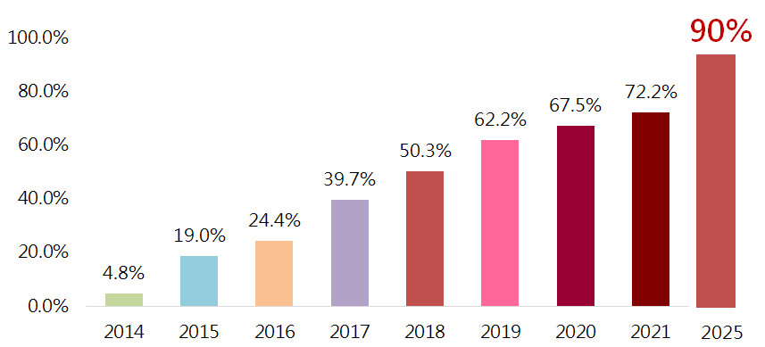
Taiwan’s Mobile Payment Development
According to the report of the Institute for Information Industry(III), Taiwan’s mobile payment penetration rate has increased to 72.2% in 2021.
Mobile Payment Penetration Rate：the proportion of mobile payment users in smart phone users in current year
Mobile Payment Definition：Making a deal with merchants through scanning QR code by smartphones or touching the reader with smartphones which have Near Field Communication (NFC) function
Source：Institute for Information Industry(III),

Slide 2
The Achievement of Mobile Payment Policy
Regular Expenses
convenience stores, department stores, supermarkets, retailers, restaurants and small-scale merchants, etc.
Public Services
gasoline stations, medical centers, taxes, utility bills, etc.
Transports& tourism
THSR, Taiwan Railways, MRT(Taipei, Kaohsiung, Taoyuan,etc.), taxis and freeway service areas
National Forest Recreation Areas, National Palace Museum, nationwide museums and cultural parks, etc.
Friendly Environment
strengthening infrastructure, incl. cyber security, mobile internet, etc.
adjusting financial regulation
establishing an e-payment cross-institution platform
Big events
offering consumers opportunities to experience mobile payment via Lantern Festival, Agriculture Expo, etc.

